Slide 1
The Retirement Application Process
Tier 1 Employees
This is for informational purposes and not intended to provide you with legal or financial advice concerning your retirement.

Slide 2
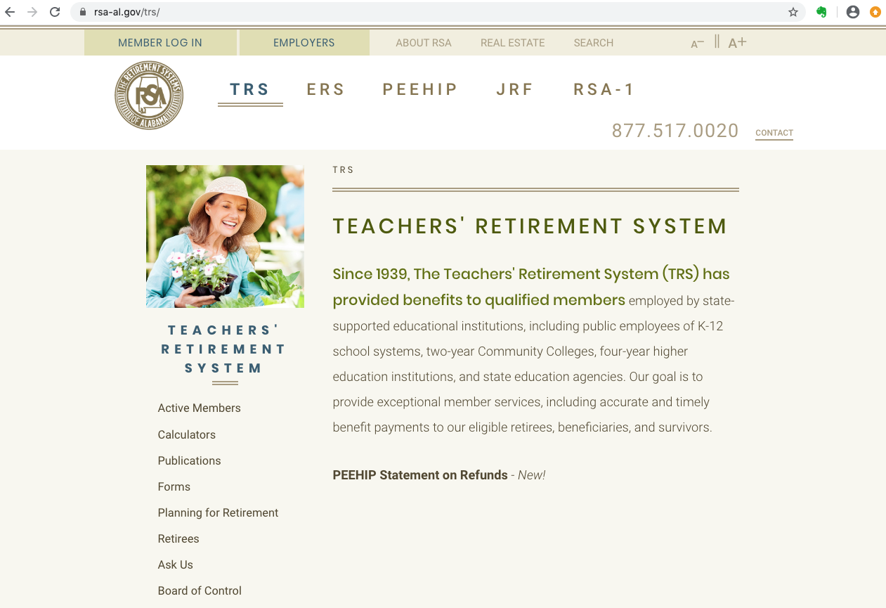
The TRS Website – Review before retirement
GREAT INFORMATION

Slide 3
Publications and Forms

Slide 4
Member Online Services (same as PEEHIP)
Member Online Services (MOS) allows you to view your TRS account statement, estimate your retirement benefit, view and/or change your beneficiary, view your RSA-1 statement, and change your address.

Slide 5
Sick Leave Conversion Tier 1 Only (From TRS Member Handbook)

Slide 6
Post-Retirement Employment
A TRS retiree may continue to receive full benefits while employed with an ERS or TRS agency so long as the following conditions are BOTH met:
The retiree is NOT employed or under contract as a permanent, full-time employee. Must be employed in a part-time capacity.
The retiree’s salary cannot exceed the limitation on earnings and the limits are subject to change each year based upon the Consumer Price Index.
For 2020, the limit is $32,000.

Slide 7
Monthly Retirement Benefit Choices
Maximum Monthly Benefit
Greatest monthly amount. All benefits cease at retiree’s death. The beneficiary receives only a prorated monthly payment.
Option I
Monthly amount slightly reduced, but allows beneficiary to receive balance of TRS account that remains (if any).
Option II*
100% survivor benefit.
Option III*
50% survivor benefit.
The retiree receives a lifetime monthly benefit with any of the choices.
*You can only have one beneficiary with Option II or III. Both are contingent upon the member AND the beneficiary’s ages. If there is a large difference in ages, there will be a significant reduction in the monthly benefit.

Slide 8
Partial Lump Sum Option Plan (PLOP)
Option for retirees to receive a lump sum payment at beginning of retirement.
In exchange for a reduced lifetime monthly benefit, the member can receive up to 24 months of the maximum monthly benefit (increments of $1,000).
TRS stresses that they do NOT want members to use this to purchase a depreciable asset, but use to pay off debt to allow member to live more comfortably in retirement.
Payment is subject to 20% withholding for federal income taxes and retirement later in the year may throw member into a higher tax bracket.
A lump sum probably puts the retiree ahead of the game for about the first 10 years, but after that, the permanently reduced monthly benefit catches up.
AGAIN, TRS STRESSES that this is best used for unsettled debts - not purchases.

Slide 9
Application Instructions
Complete ALL portions of the packet and return to Human Resources (Do NOT send portions to TRS)
Packets must be received in HR no later than the 15th of the month prior to your 30 day deadline to submit to TRS
Human Resources will route your packet to the appropriate departments for completion
We will notify you when your packet is ready for you to pick up – you must mail or hand deliver to TRS
For any detailed questions regarding your monthly benefit, service credit or insurance costs, please contact TRS directly at 1-877-517-0020
Remember that we are NOT the experts, but will guide you through the process

Slide 10
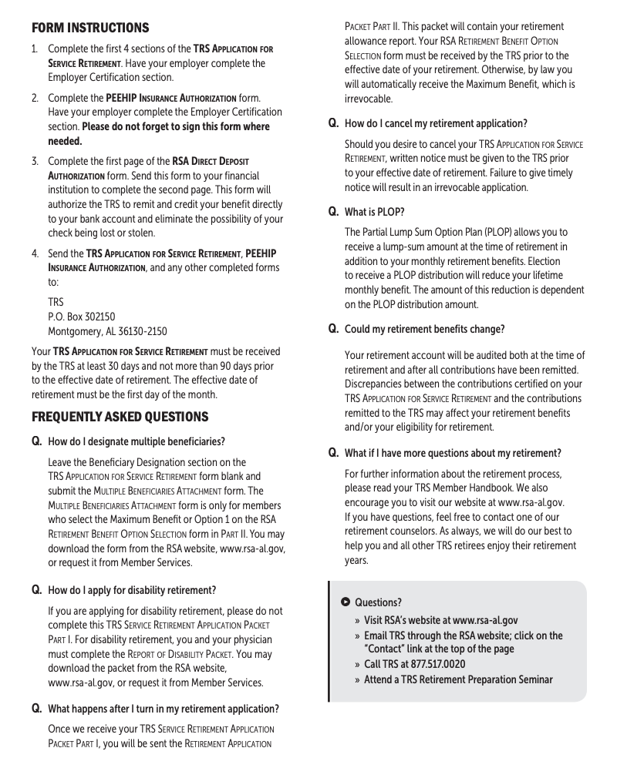
APPLICATION PACKET
Return packet with all portions that you must complete to HR NO LATER than the 15th of the month prior to your 30 day deadline. We have a notary on staff and will notify you when the employer portions are complete for you to pick up your packet to mail. We will NOT mail packets for you.

Slide 11
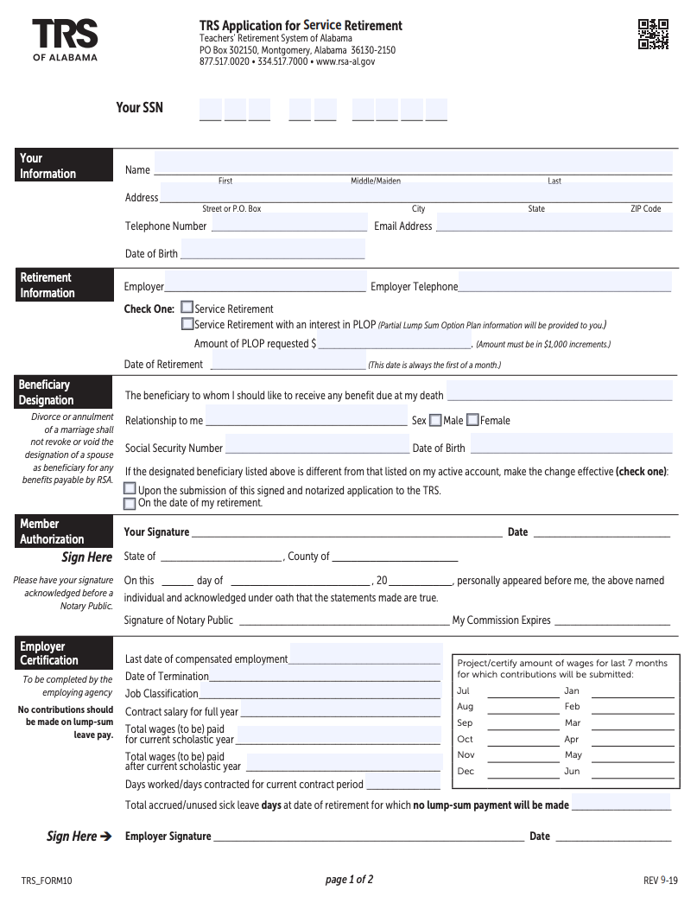
You complete
We complete

Slide 12
You complete
We complete
You review and complete if needed

Slide 13
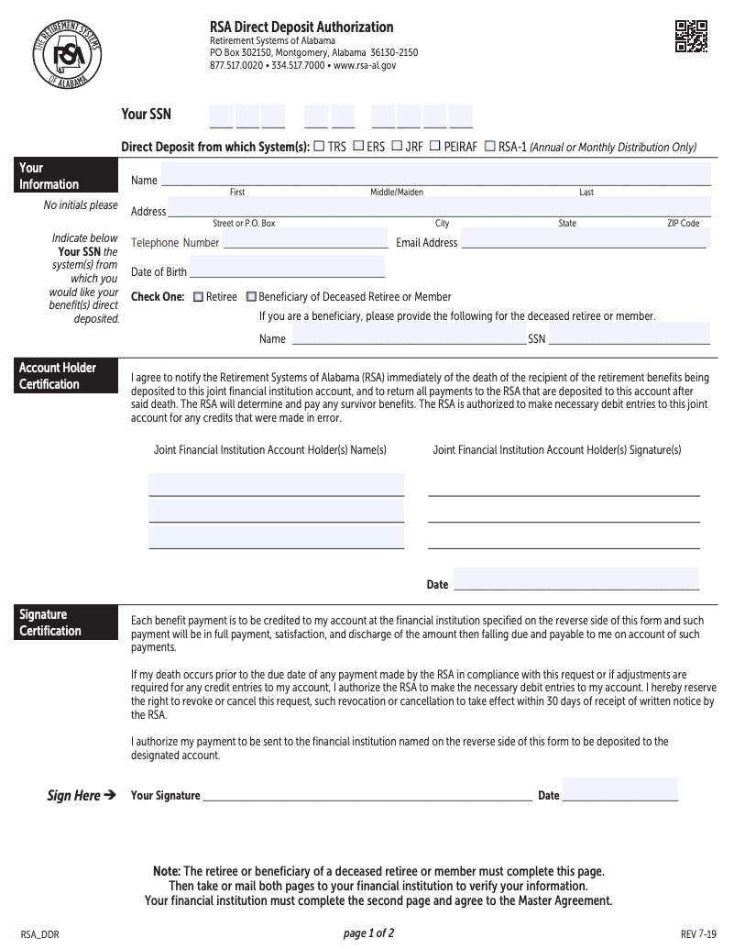
You complete all of this page

Slide 14
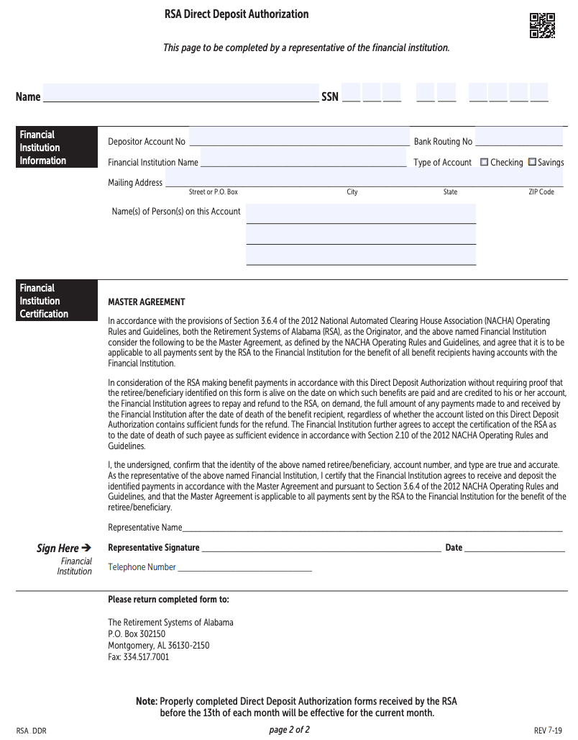
Your financial institution will need to complete this page
Note: Direct Deposit will be delayed if you wait until the 15th to submit your paperwork

Slide 15
Finishing your application…
Bring your packet to Human Resources (including your TCSS Notice of Resignation/Retirement). Our office closes at 4:30 p.m., so please arrive no later than 4:00 p.m. if you need assistance.
We have notaries available to notarize your signature. We will complete the employer certification portion.
Once your application has been completed by our office staff, we will notify you so that you can pick up your packet and mail to TRS. We do not mail the packets for you. It is your responsibility to ensure that your retirement application is delivered to Montgomery by the deadline.
Applications must be received by the 15th of each month to allow us the opportunity to complete the employer certification and mail to Montgomery for receipt by the 1st of the month (if that is your deadline).

Slide 16
Questions?

Slide 17
THANK YOU for your service to our system and the children you have positively impacted through your work!

